Slide 1

Accredian Telecom Data Analysis EDA Project form Accredianians
1004 Group
Abhishek thakur 5.Lucky
Bindu 6.Shailesh
Emily 7.SNEHAL
Pardeep 8.VISHNU

Slide 2
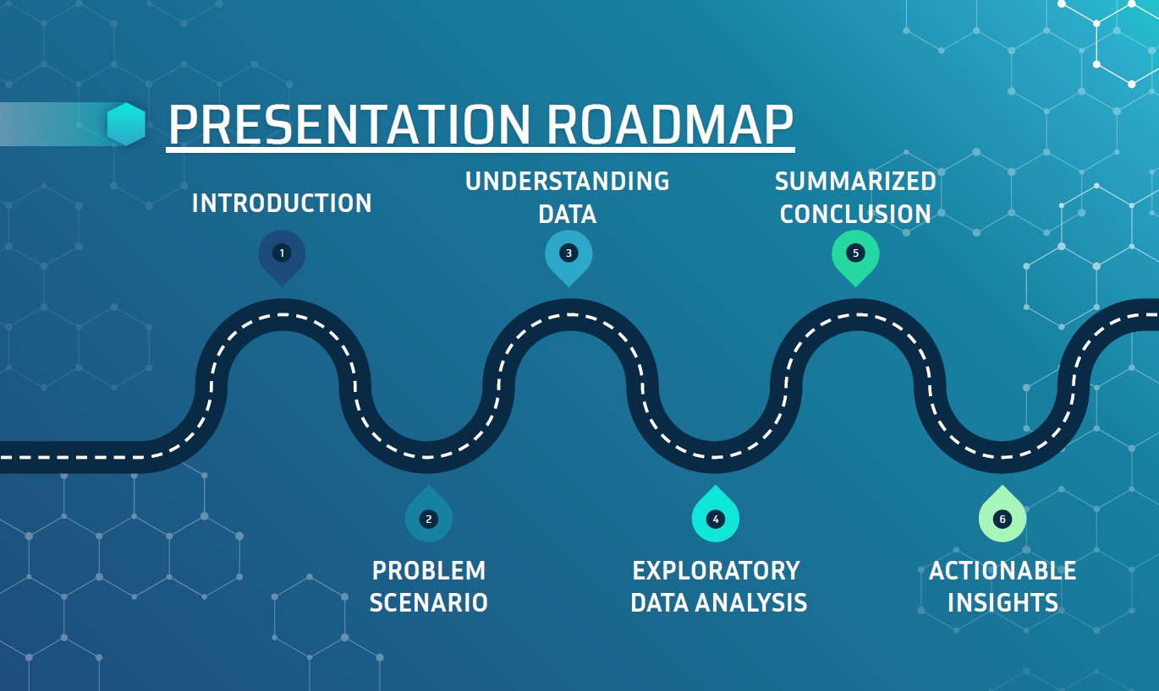

Slide 3
INTRODUCTION
AccredianTelecom, one of the leading telecom players
AccredianTelecom is a Telecom networking service company. which allows users to connect among friends or people.

Slide 4
Problem Statement
AccredianTelecom, one of the leading telecom players, understands that customizing offerings is very important for its business to stay competitive.
This company approaches Accredianians, and asks them to come up with dashboard will help us to understand a user's demographic characteristics based on their mobile usage, geolocation, and mobile device properties

Slide 5
UNDERSTANDING OF DATA

Slide 6
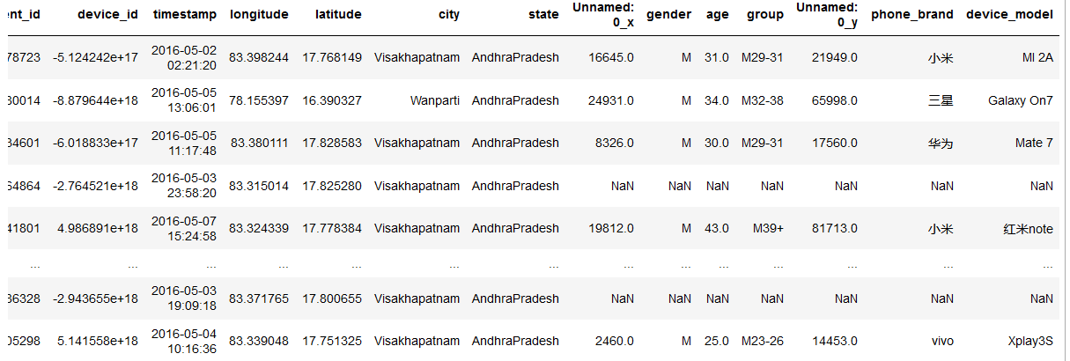

A QUICK LOOK AT THE SAMPLE OF THE DATASET

Slide 7
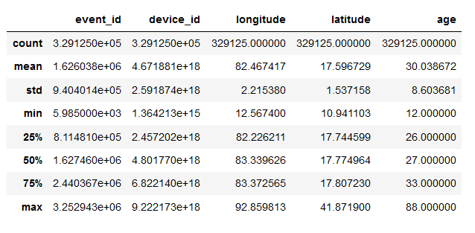
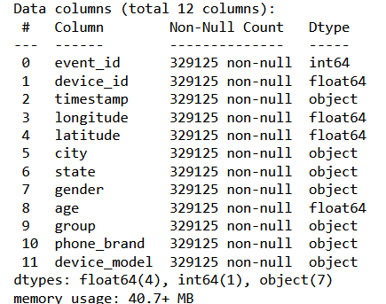
A QUICK LOOK AT THE STATISTICS OF THE DATASET

Slide 8
EXPLORATORY DATA ANALYSIS

Slide 9
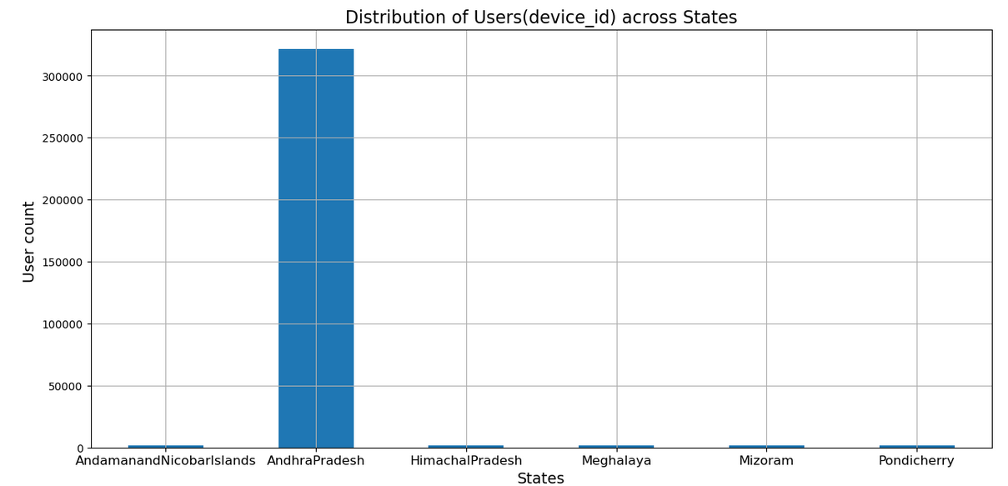
Andhra Pradesh, a state in India, has a significant number of users.
This slide will provide an overview of the user statistics in Andhra Pradesh

Slide 10
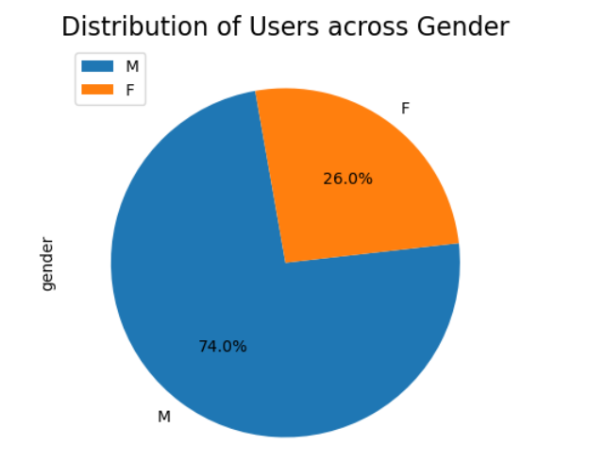
The user base consists of 74% male users and 26% female users.
This data indicates a slight majority of male users

Slide 11
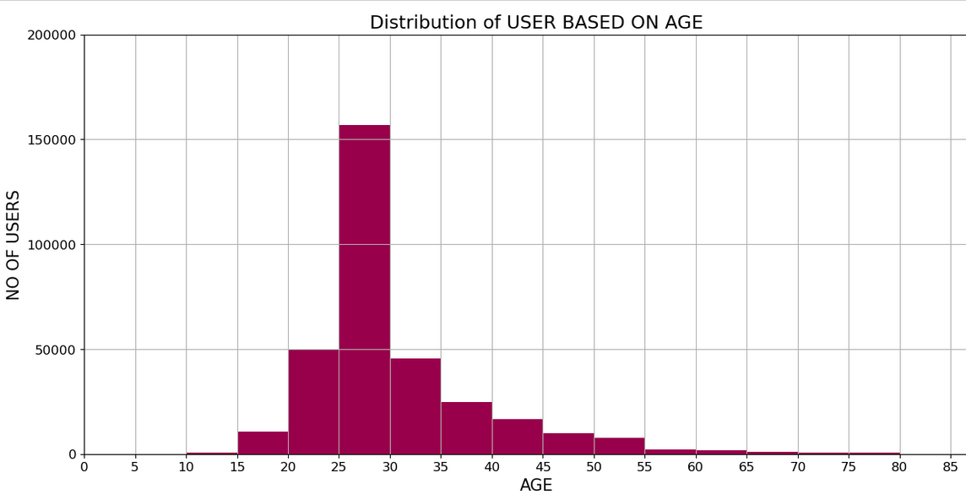
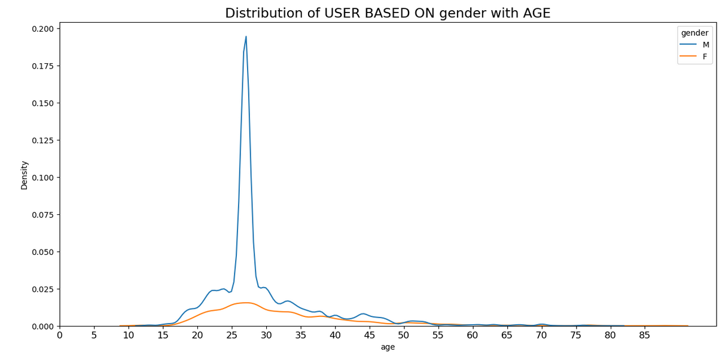
Based on comprehensive data analysis, we have found that the majority of our users fall within the age range of 20 to 35.

Slide 12
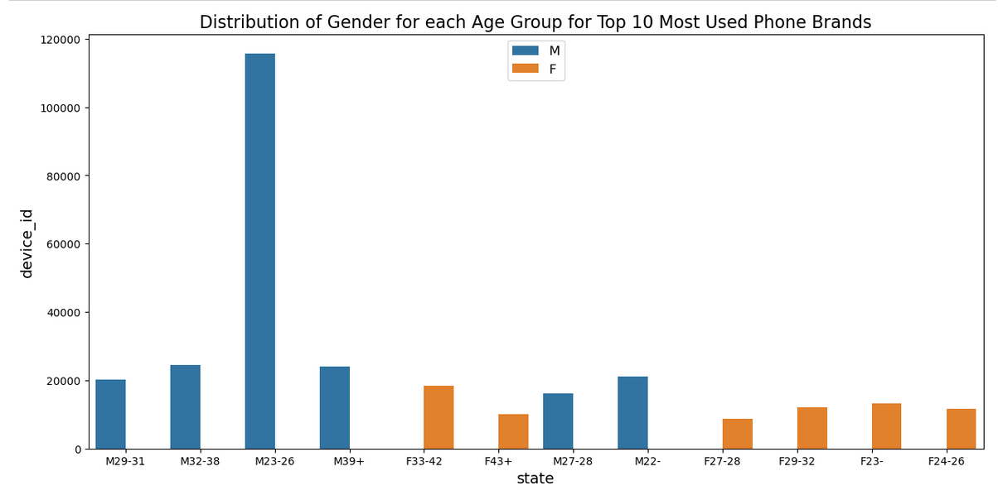
-MALE USERS FORM THE AGE GROUP M23-26 ARE HIGHEST
- FEMALE USERS FROM THE AGE GROUP f33-42 are highest

Slide 13
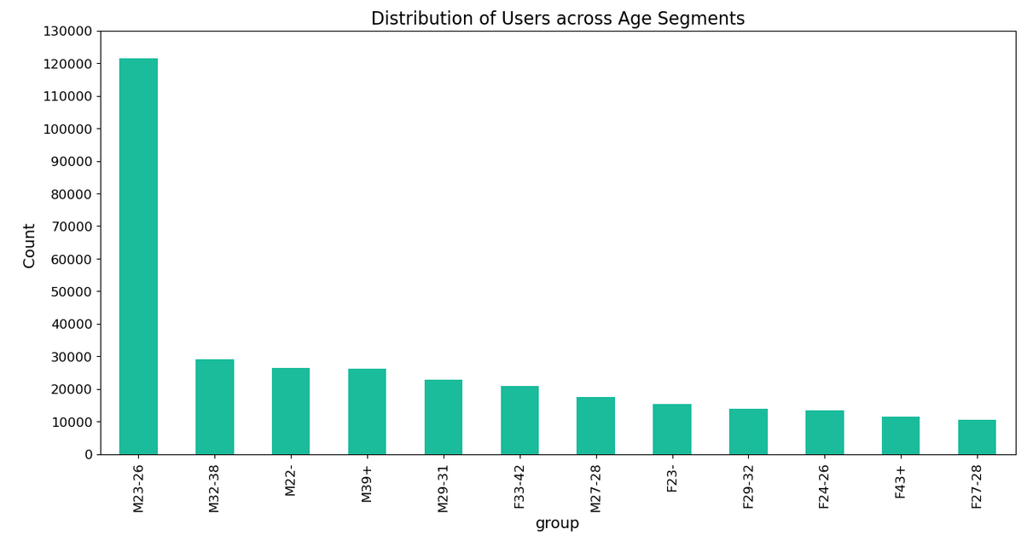
Understanding the user demographics is crucial for effective targeting and tailoring of products and services.
The age group M23-36 exhibits the highest number of male users.
The age group F33-42 exhibits the highest number of Female users

Slide 14
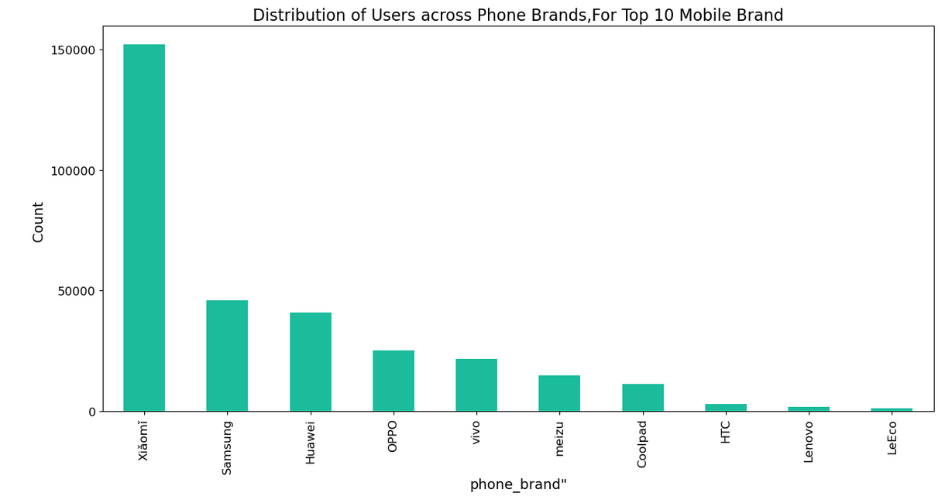
The global smartphone market has witnessed significant changes in recent years, with consumers embracing a variety of brands and models.
Highlight Xiaomi, Samsung, and Huawei as the leading brands.
Xiaomi - Rising in Popularity

Slide 15
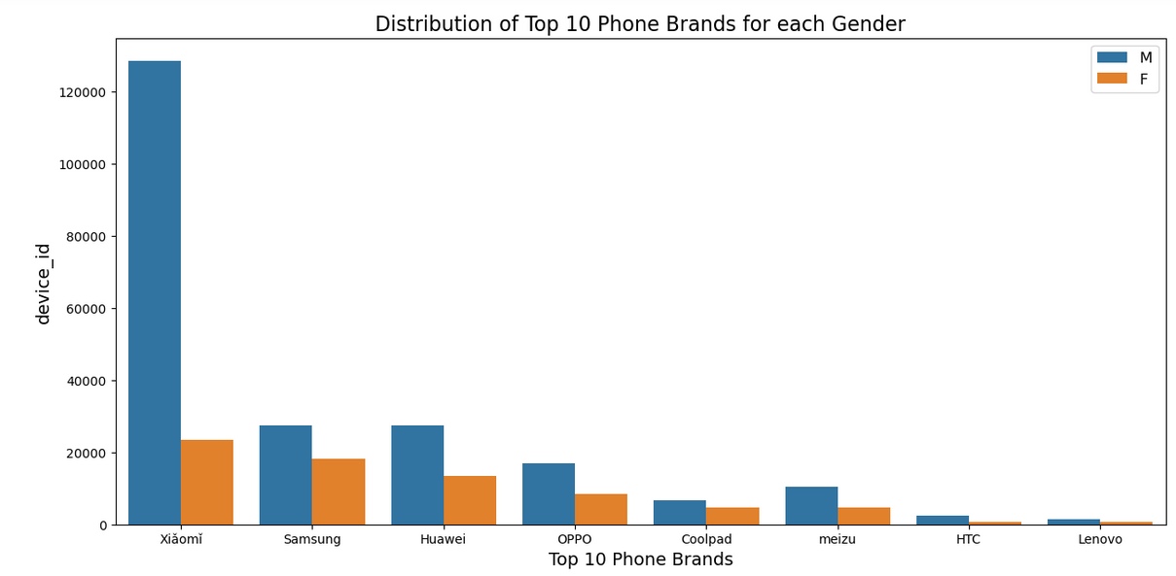
Male users are IN MEJORITY for variety of brands.
Xiaomi - Rising in Popularity.

Slide 16
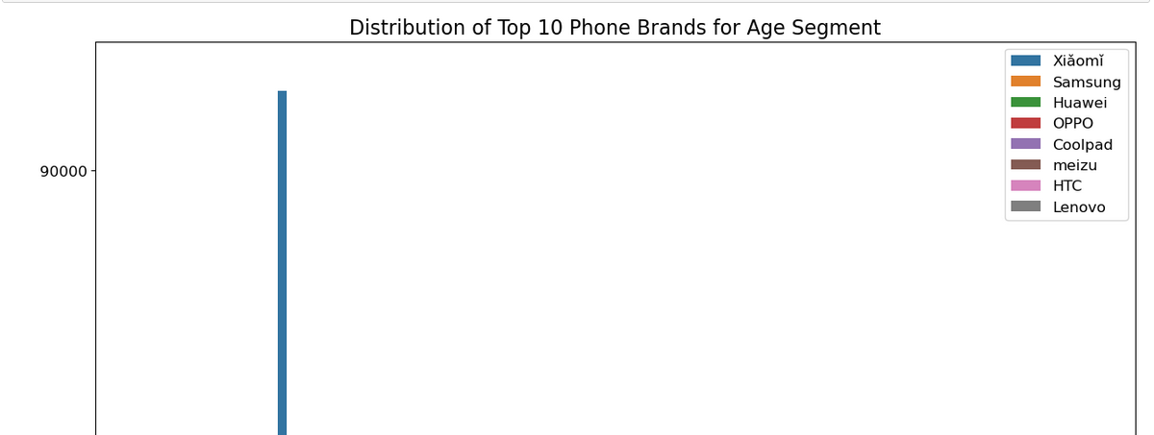
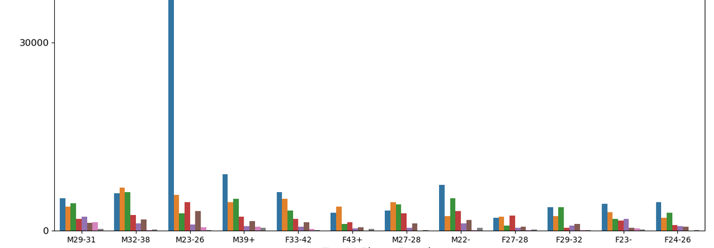
Xiaomi Brand is Rising in Popularity FOR the age group M29-31,M32-26,M39+,F33-42,M22,F29-32,F23-,F24-25
Samsung brand is Rising in Popularity FOR the age group M32-38,F43+,m27-28,f27-28.

Slide 17
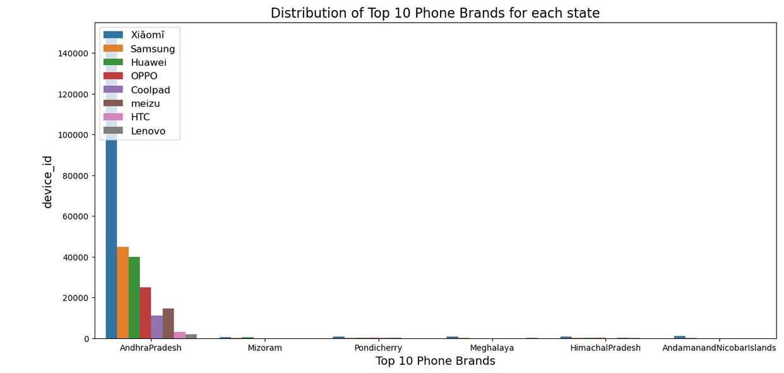
Xiaomi is Rising in Popularity in each State

Slide 18
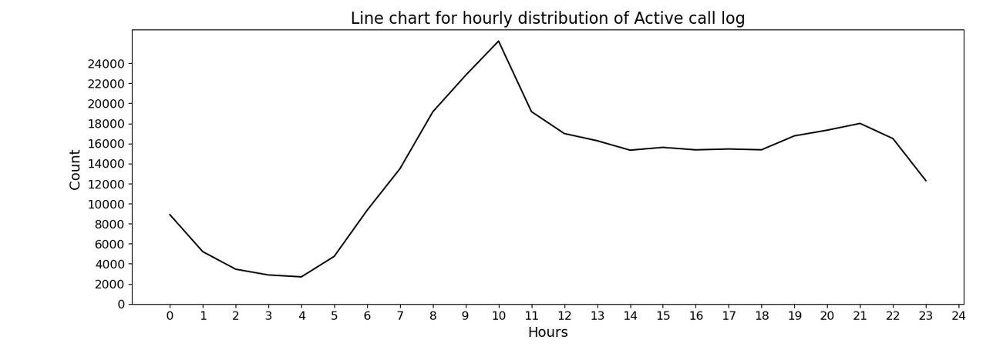
users are highly active during the designated call hours, specifically from 8.00am to 9:00 pm

Slide 19
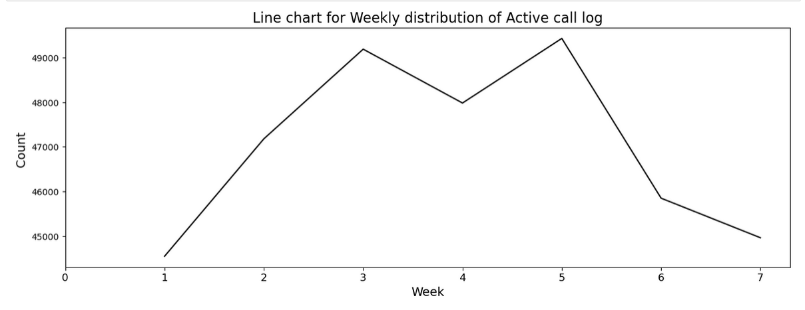
Users tend to be less active on calls on Sundays and Saturdays
Possible reasons for decreased activity (e.g., rest days, family time)

Slide 20
Geospatial Analysis

Slide 21
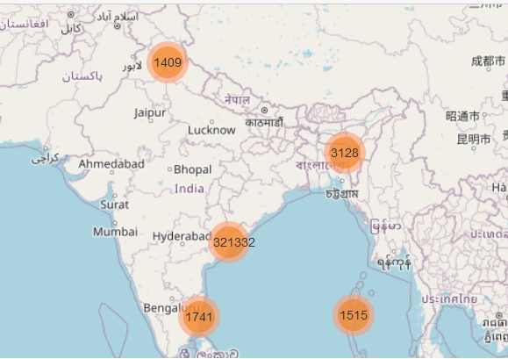
Geospatial Analysis: Mapping user data FOR geospatial analysis.
Andhra Pradesh state in India, has a significant number of users.

Slide 22
SUMMARIZED CONCLUSION
Extrapolation process utilized to infer information about the user dataset, This data consist of 74% Male users and 26% female users, Data indicates majority of male users.
Andhra Pradesh, a state in India, has a significant number of users.
Highlight Xiaomi, Samsung, and Huawei as the leading brands. Xiaomi - Rising in Popularity.
The Majority of our users fall within the age range of 20 to 35.
The age group M23-36 exhibits the highest number of male users. & The age group F33-42 exhibits the highest number of Female users.
Users are highly active during the designated call hours, specifically from 8.00am to 9:00 pm.
Users tend to be less active on calls on Sundays and Saturdays

Slide 23
ACTIONABLE INSIGHTS
The age range of 20 to 35 is a prime phase of life characterized by a higher degree of digital engagement and technological adaptability. Your platform has successfully attracted a considerable number of users within this age bracket, reflecting its relevance and appeal to this demographic.
One of the key findings from our analysis is that our users are highly active during the designated call hours, specifically from 8AM to 9 PM. During this timeframe, we observe a significant increase in user engagement and participation. This information is crucial for optimizing our services and improving user satisfaction.

Slide 24
THANK YOU!
You can find me :abhishekrcks1995@gmail.com
Please share any feedbacks over mail.

